Slide 1


Library Academic Support
Helping you get the best from the Library, its collections, resources and services
Searching and reviewing
the literature
  Section 2:
  Academic literature databases
This presentation:
http://www.docs.is.ed.ac.uk/docs/Libraries/SearchingAndReviewingLiterature2.pptx
Rowena Stewart
(she/her)
rowena.stewart@ed.ac.uk
Academic Support Librarian
Research in Health, ODL MSc.
AY24-245 Sep24
Notes:
Hello everybody and welcome to what is section two of the searching and reviewing the literature presentation. In this one we will look at searching academic literature databases, such as CINAHL, to find journal articles on a topic.

Slide 2
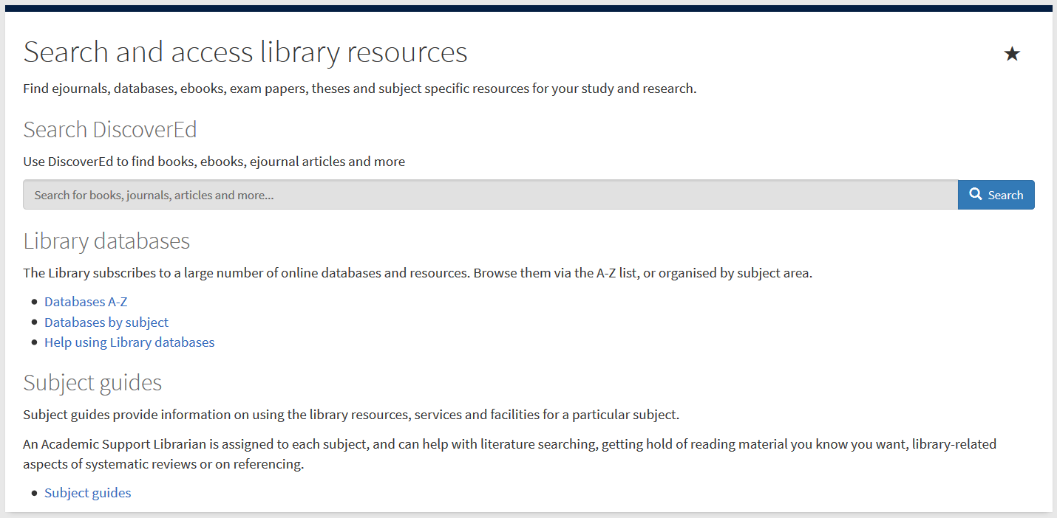
Abstracting & Indexing (A&I) databases
Library Academic Support Team
Include material not found in DiscoverEd or Google Scholar.
Contain details of millions of articles from 1000s of publications.
  Conference proceedings, journal articles, book chapters, reports and standards.
MyEd > Studies > Library column
Subject specific databases.
Databases by subject
www.ed.ac.uk/is/databases-subjects
Notes:
Academic literature databases are also called abstracting and indexing databases which is an indication of why they are useful. They contain records for predominantly journal articles (but also book chapters and theses and other types of material depending on the database’s focus). The information recorded is typically citation information, an abstract and words and phrases which further describe the content and are drawn from a thesaurus each database maintains for the purpose.
These sorts of databases go beyond the contents of journals etc for which one particular library provides access (DiscoverEd is good for that though). They also go beyond one publisher’s output as well and they tell you more than you can find out about from things like Google Scholar or just a web-based search.
They are designed for people like you to find out what exists on a topic, and having been around for a long time (“before the internet”) they have functions and features which help with this kind of task.
There are abstracting and indexing databases, such as Web of Science (despite its name) and Scopus, which are created to cover all academic disciplines. There are also ones which index journals publishing in a particular area, such as engineering, divinity or law but also psychology, medicine and nursing.
You can investigate the databases which may be useful in a particular subject area from the library webpage “databases by subject” and perhaps the easiest route to that is via MyEd’s “Search and access library resources” section its Studies’ Library column.
The arrow is pointing at the link to the databases by subject page which just takes you out of MyEd and into the page on the library website.

Slide 3
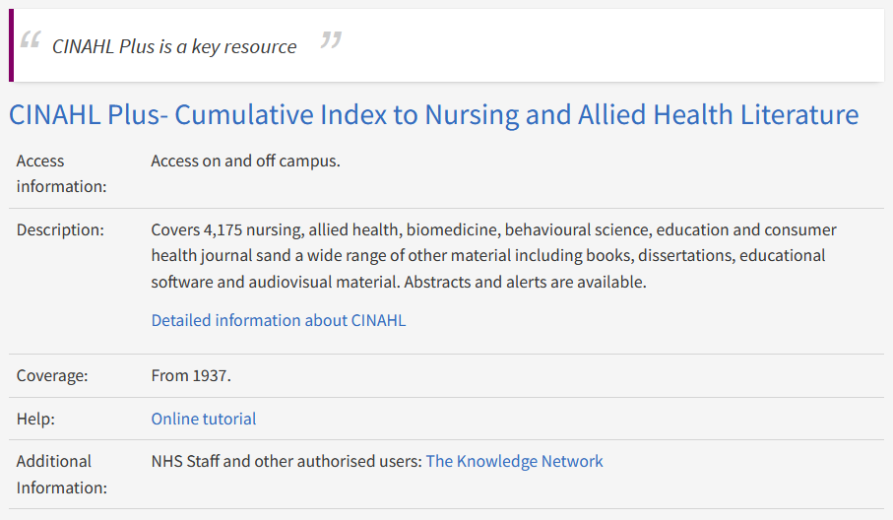
Databases for Reviewing the Literature
Library Academic Support Team
Nursing databases
Title is the link to the resource
www.ed.ac.uk/is/databases-subjects > Nursing
Notes:
When you have gone into the page for the subject area you think the best fit, Nursing perhaps!, you see an alphabetical list of resources which the library buys and which may be useful to you. It is not just abstracting and indexing databases which are listed. There may also be collections of full-text or videos relevant to the area and other types of resources too. The “Description” section of each helps you know what may be useful for your particular purpose.
In the Nursing list some are highlighted as “a key resource” like the one on the slide here, CINAHL Plus, which suggests they are one of the ones to start with.

Slide 4

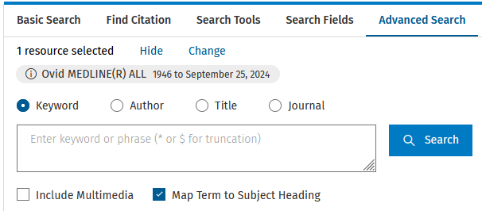
Databases for Reviewing the Literature
Library Academic Support Team
Default search can be of a database’s thesaurus of “Search Terms”…
(or “Subject Headings” or “Descriptors”)
“Keyword” type search:
Remove the tick and “Search” will return database records which contain the words/phrases entered.
Notes:
One of the useful features that academic literature databases have are “descriptors", "subject headings", or "subject terms" which are words and phrases selected from a thesaurus and consistently applied to a particular database’s records. They help describe the content of the paper the record is describing. Knowing how a database describes a topic you are interested provides you with potentially good synonyms.
Looking up a database’s thesaurus of subject headings or subject terms is turned on by default for CINAHL and also for some of the other health and medicine databases, including those on the Ovid platform, which are MEDLINE, Embase and psycINFO.
The tick that you can see pointed at with the blocked arrows are against CINAHL’s "Suggest Subject Terms" in the top screenshot and against "Map Term to Subject Heading" for MEDLINE on the Ovid platform in the screenshot underneath. A search with these ticks on will return information about subject terms, not records with your search terms in them.
If you want to just find records which have in them your words and phrases somewhere - you take off the tick and the search becomes more of a "normal", keyword type search, looking for your words or phrases in the title, in the abstract, and in the subject heading fields of the record.
However, when you go to CINAHL or into MEDLINE from the web page links, the tick will be on and the search will be of those databases’ subject headings.

Slide 5
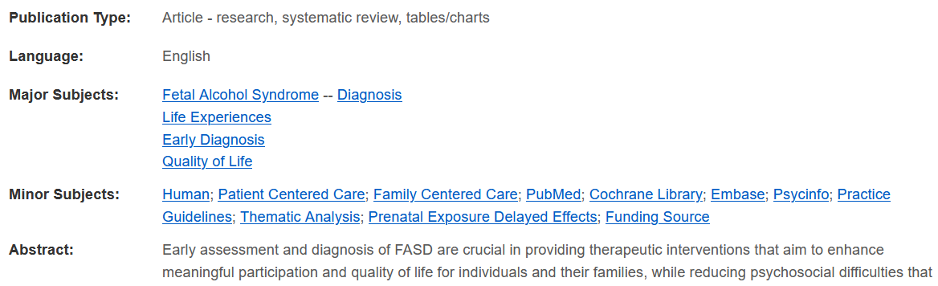
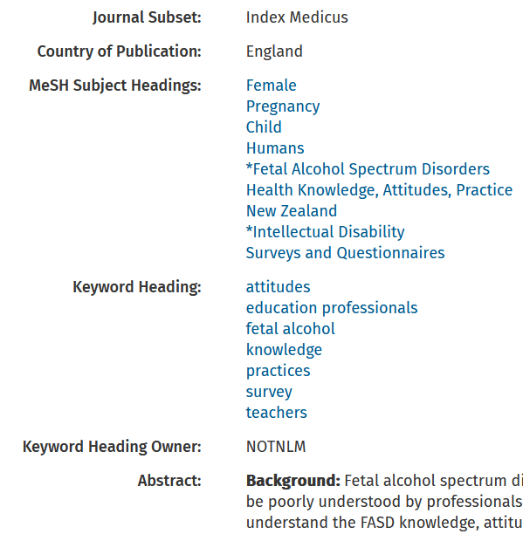
A&I database Subject Headings
Library Academic Support Team
Subject headings/terms are words or phrases added to records in a database.
Describe the content of an article etc
Consistent in their application across the records in one database.
CINAHL records have a Major Subjects field and a Minor Subjects field
The words and phrases used in the original publication to describe an article are often given in a database record
Only consistently applied on single author’s output or within a single publication
Notes:
The screenshots here are, on the left, from a CINAHL record and on the right from a MEDLINE record and highlighted in the curvy corner rectangles are the subject heading fields.
CINAHL has two, a "Major Subjects" field and a "Minor Subjects" field.
MEDLINE has the one which it calls "MeSH Subject Headings" (although MeSH stands for MEDLINE Subject Headings).
As we said, they describe the content of an article and are consistently applied within a database. As you could guess from the way they look, you can click on them and get back those records which have the term in their own subject headings. However, not all records have them added. For example, the more recently added records may not have been fully processed yet and will be missing this added value type information.
However, if one matches any of your concepts it is a good way of finding lots of papers on the right subject.
The MEDLINE screenshot (on the right) includes the "Keyword Heading" which are added by an author or perhaps a publication, so they are not consistently applied except by that author or within that single publication.

Slide 6

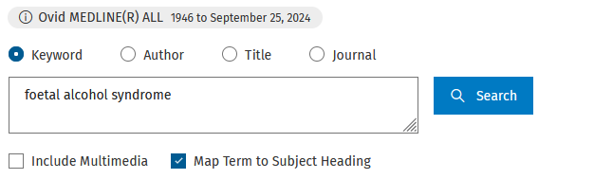
Library Academic Support Team
A&I database Subject Headings – looking them up
Search headings are database-specific.
A Suggest / Map search tells you if a database uses subject headings which match any of your concepts
Notes:
Back to the default search which looks up subject terms or subject headings and the example here is looking up what they could be for foetal alcohol syndrome.
Just in passing, you will note the spelling I have used is the British spelling of foetal.

Slide 7
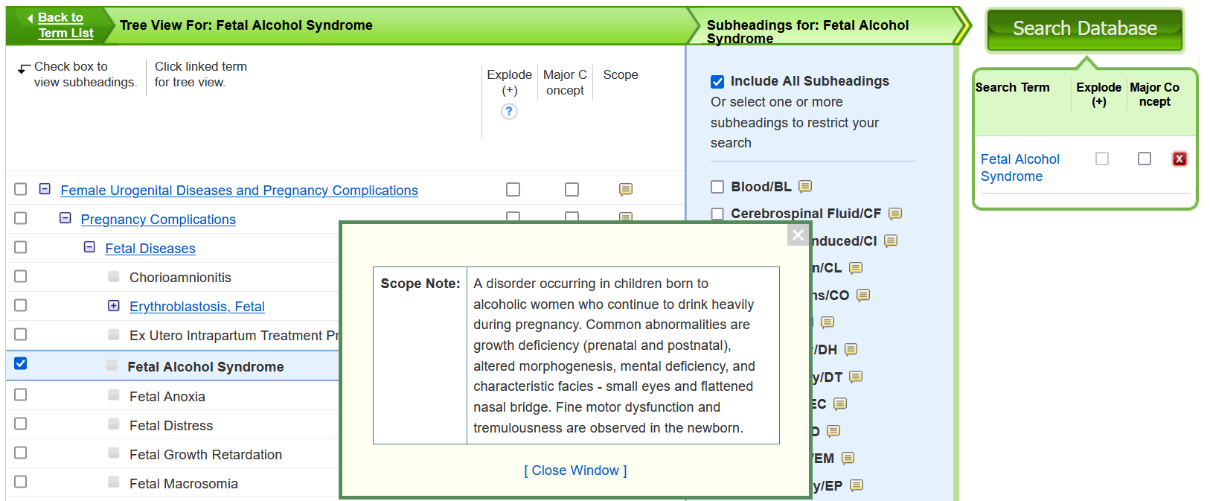
Library Academic Support Team
A&I database Subject Headings – CINAHL display
Subject terms/headings are arranged in classification schemes or trees
Scope notes give a description of article content which triggers addition of the subject heading to a record.
Notes:
This shows a CINAHL view of the subject term it uses for foetal alcohol syndrome.
Subject headings or terms are arranged in classification schemes or tree, starting with broader headings which get more specific as you go down the tree or down the scheme.
The tree shown here shows that "Fetal alcohol syndrome", the one ticked off to the left there, falls under (is considered a more specific kind of) "Fetal diseases", which itself falls under "Pregnancy Complications". Sometimes the more specific or the broader terms may suggest themselves as being useful for finding relevant material on your topic.
For CINAHL, a subject term may appear in more than one "tree", but the context may be useful for you in some cases in orientating the concept foetal alcohol syndrome, amongst other possible "Problems" that may be of interest.
The "scope note" that is highlighted (the ringed callout symbol) gives a description of what an article would have to be about for CINAHL, in this case, to apply in the minor or the major subject field, the term "Fetal alcohol syndrome". Checking the definition means you can check to see if what you mean by a particular concept, foetal alcohol syndrome, is how CINAHL also determines it too.

Slide 8
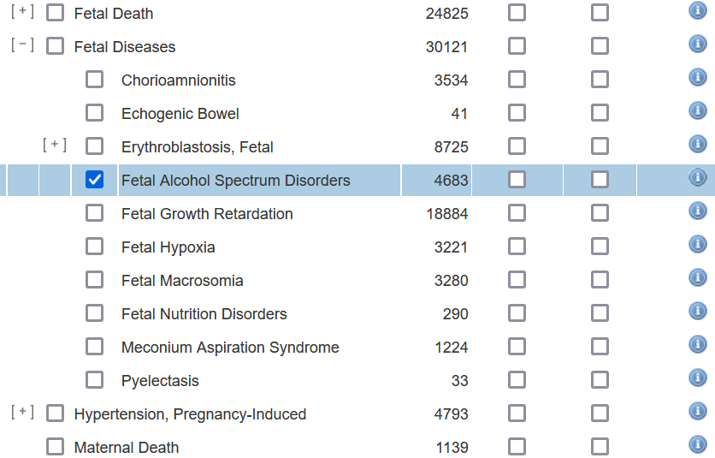
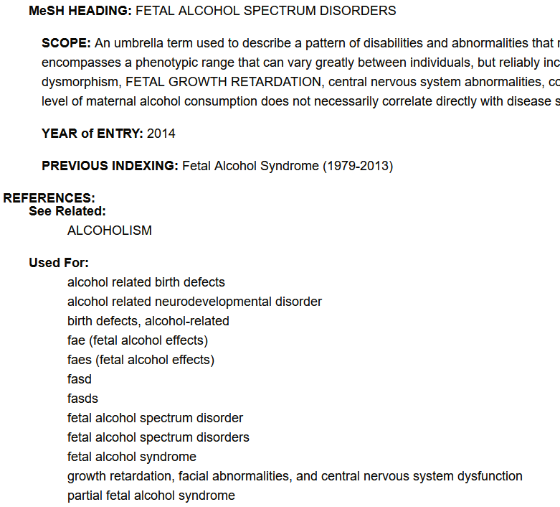
Library Academic Support Team
A&I database Subject Headings – MEDLINE on Ovid display
Many databases are produced in North America and subject headings can be a good reminder of differences in spelling as well as terminology.
“Used For:” type entries are other, sometimes older, terminology
Notes:
Here we are looking at the way that Ovid MEDLINE presents its subject headings, again in a classification scheme or tree and we see that MEDLINE uses "Fetal Alcohol Spectrum Disorders" on records for articles about foetal alcohol syndrome. Knowing this may add another good phrase to use, to find papers which are relevant for your foetal alcohol syndrome search.
For both CINAHL and MEDLINE you will have noted the spelling of fetal is North American. If you had not already thought of spelling it, foetal, in that way, __ETL rather than just __OETL, then the subject headings can be a good prompt.
In the scope note, which in this case for Ovid MEDLINE, is the little “information” symbol (the white "i" in a blue circle), you get the description of what an article has to be about for "Fetal Alcohol Spectrum Disorders" to be added to the subject heading field of a record, you also get a "Used For:" list which the bottom arrow is pointing to. The words or phrases listed there are sometimes older terminology but you can also see (three up from the bottom) "fetal alcohol syndrome" which reinforces the fact that MEDLINE uses "Fetal Alcohol Spectrum Disorders" where authors might have used foetal alcohol syndrome.
There may be other terms that you want to add as synonyms as well, if they seem right.
The search that happens when you continue from the thesaurus search looks for the words or phrases that you have selected in the one field (two in CINAHL).

Slide 9
Library Academic Support Team
A&I database Subject Headings → search terms
PRO:
Records with the right database subject heading added will be for articles etc which are on that topic.
Found using one search term.
CON:
Records in a database without a Subject Terms/Heading field will be excluded from results of a search limited to just them.
This may include recently added records of the most recently published research.
Subject Terms/Headings are database-specific so have to search each database separately, using the right headings for your concepts
Notes:
Searching this way has the advantage that you are definitely going to find records on the concept.
The disadvantage is that there will be records in the databases which have not been fully processed yet and are without Subject heading/term field data added yet and are automatically excluded from the results. These may be the most recently added records.
Another disadvantage is that databases on the same platform can be searched at once but their collections or thesauri of subject headings differ. They may have headings which are the same but, unless you have checked, you cannot guarantee it. This means searching one database at a time if you are using a subject heading search in the subject heading field as a way of finding relevant papers.
Therefore, what you may choose to do is to look at the subject headings for the different databases and "harvest", or note down, the different subject headings for your concept, which seem appropriate, then just use them as search terms, as synonyms, in a keyword search.

Slide 10

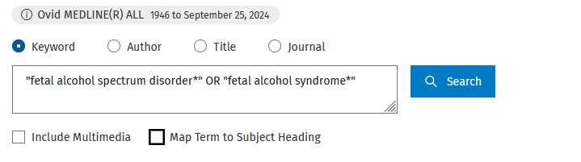
Library Academic Support Team
A&I database Subject Headings → search terms
Use a database’s thesaurus of subject headings:
To identify the terms used for your concepts
Add those terms to the synonyms.
Then run a keyword search
Truncation
Phrase marks
Notes:
To do this, as we said before, you take off the tick against "Suggest Subject Terms" for CINAHL or against "Map Term to Subject Heading" in the Ovid platform and enter your chosen search terms.
You will recognise from the previous presentation that the examples on this slide use "phrase marks" or “double quotes” around words which I want to be found together in the order have I put them (not just all being present in a record but not necessarily together as a phrase).
I have also truncated disorder and spectrum by adding an asterisk (*) at the end of them so that both singular and plural forms of each are looked for (without having to enter the plural forms of the phrase in as well as the singular).

Slide 11
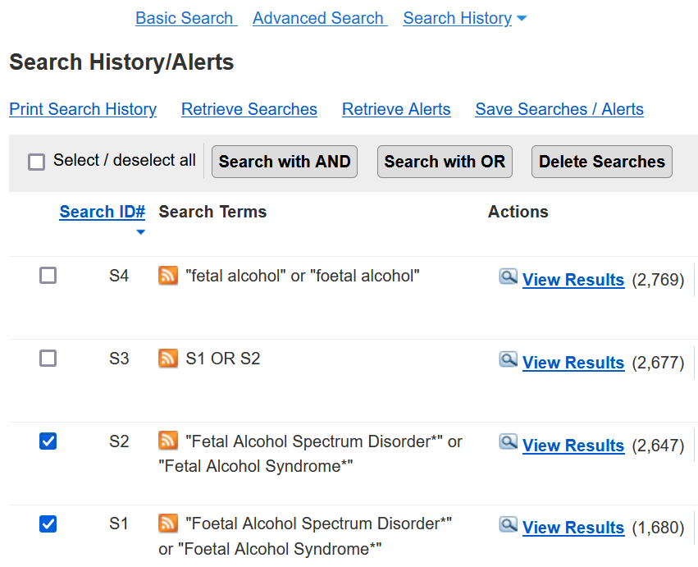
Library Academic Support Team
Search History – CINAHL
May have to choose to show the Search History which:
Lists the searches done in a browser session.
Shows number of results found.
Allows combining of search sets.
Build a search as you read more.
– see what happens to results when different search terms are used.
Try different approaches
– alternative synonyms and combinations of concepts
Notes:
Another useful function or feature offered by abstracting and indexing databases is a "Search history". The search history (sometimes called "Recent Searches") area, lists the searches you have done in a particular browser session. It lets you try out different combinations of search terms or concepts and work towards a successful search strategy in a more organic way, as you go along.
For example, you may be unsure about whether or not to use some of your possible synonyms or to use all your concepts in a search. Others you will be more certain about. A search history lets you split up a search into chunks and then combine them in different ways. Therefore, you can do a search on each concept separately using the terms you are most sure about for each, review the results and think, oh, well, perhaps I could add this as a useful term as well, and see what difference it makes to the results.
Often the search history display is a closed section, but if you click on the link, it will open up and display the searches that you have done that session.
On display here are four searches that have been done in a CINAHL session.
I started with a search of British English spellings for the phrases "foetal alcohol spectrum disorder*" OR "foetal alcohol syndrome*". Then I remembered I should also look for the North American spelling of fetal (Search 2) and created one search set with the results from both (Search set 3) by ticking the box beside the number of the (two in this case) searches I wanted to re-use, then selecting “Search with OR” from the menu in grey towards the top of the Search History space.
The number of results returned by each search are off to the right, (enclosed in brackets) and tell me that including the different spellings for foetal (Search 3), increases the number of results. Which is to say, for this particular search in this database, the British English spelling adds about 30 more than using the North American English only.
The 4th Search was me investigating what happens when the spectrum disorder and the syndrome parts of the phrases are dropped, and this, again, has added more, about 100 or so, which suggests this might be a good way of catching relevant material without worrying whether authors termed it a syndrome a disorder or something else.

Slide 12
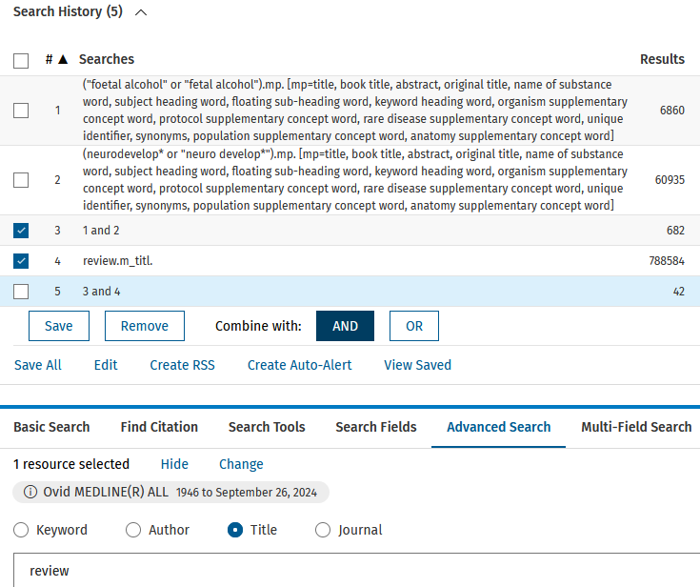
Library Academic Support Team
Search History - MEDLINE
Look for terms in just the title for articles etc which are strongly on topic.
Or use to quickly find review type articles within a search set.
Notes:
On display here is a Search History from an Ovid MEDLINE session in which I used the foetal alcohol search (Search 1, at the top) then did a completely new search for neurodevelop* OR “neuro develop*”. Keeping the concepts separate means I know that in MEDLINE, the foetal alcohol set (concept) is the “limiting” one of these two, returning the smaller number of results (6,860).
This is still a nice big number so I was not worried when I put the two concepts together. This is done the same way in the Ovid platform for MEDLINE as it was in the EBSCOhost platform for CINAHL illustrated in the previous slide: tick/select searches 1 and 2 then use the appropriate command button, in this case AND, because I wanted at least one of each term from the two separate searches to appear in the results –neurodevelopment as well as foetal alcohol. Doing this takes the result numbers down from the maximum they could be of 6,860 to just under 700.
You can usually afford to be broad in how you look for each concept, which is to say synonyms with OR, because when you start putting concepts together, using AND, the numbers go down quite quickly.
However, 682 is still a large number of results but there may another concept I know I want to read about as well as these two, and I could search on that, add it to the oterh three and see whether I think it is a good way of getting to what I want to read about. However, in this illustration, I decided I wanted to see if there was a review type article I could start with and a quick way of doing this is to search for the word review in the title field only. We looked at doing this in the advanced search of DiscoverEd in the previous recording and it is the same in abstracting & indexing database interfaces.
To tell MEDLINE to look for a term in the Title only, choose the radio button labelled “Title” just above the search box (at the bottom of the picture here). In CINAHL you would choose from the drop-down menu options against the search boxes, just as for DiscoverEd.
This search returns a huge number of results (over 780,000) but I only want to know how many of the 682 with foetal alcohol and neurodevelopment terms, also have the word review in the title. Therefore, I select searches 3, 4 and the button AND this time (all with the purple dotted rings around them) to find out that 42 records in MEDLINE may be reviews of the literature on some aspect of foetal alcohol syndrome/spectrum disorder and neurodevelopment.
If any are systematic reviews, they may be useful in seeing how others have approached a systematic style review search in a similar area. Perhaps providing words and phrases, or other search approaches, which could be useful for you.
The search history area is handy for playing around, trying different combinations of synonyms and for building up a search that is going to work well for your particular literature sourcing needs.

Slide 13
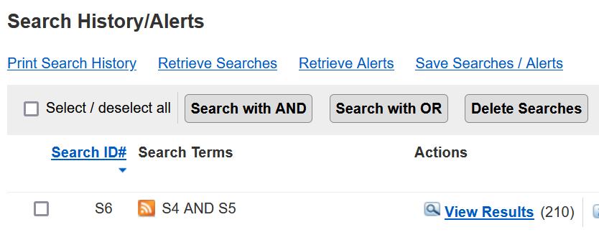
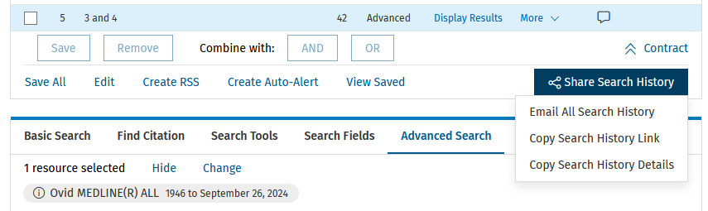
Library Academic Support Team
Search History – recording search methodologies
Save Searches / Save All to have commands saved for re-running on another visit.
Retain as reminder for what databases you searched, the search terms used and the numbers found.
Notes:
If, for a piece work you know you have to report how you did a literature search and the numbers of records found, there are Search History functions which are useful to know about. It is also worth remembering that Search Histories clear if your search session times out and when you exit or leave.
However, the purple dots ring those commands in the Search History areas of CINAHL (above) and MEDLINE (below) which allow you to save a set of search steps in a personal account space on the database platforms, for which you would register. When you have saved the steps you can come in another day and, “Retrieve” or “View” what you have saved to have the database run the search for you without you have to do anything else.
For a record of what you did and got for a particular search session, use the "Print Search History" for your CINAHL searches, and options under “Share Search History” in Ovid MEDLINE, to email or copy to save. You get a copy of what is presented in the Search History, including the name of the database(s) searched as well as each search listed with the number of results returned.

Slide 14
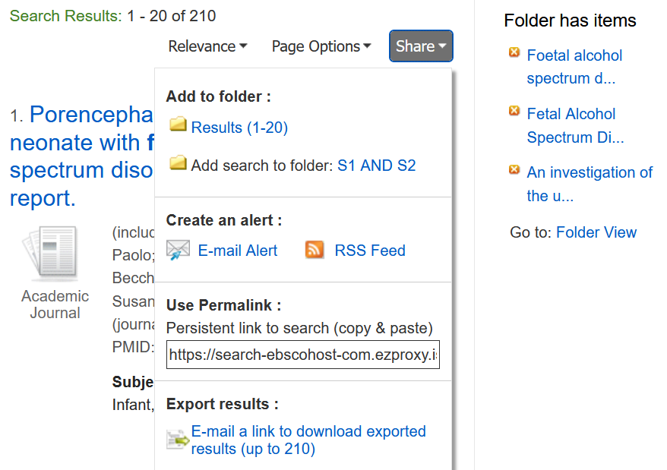
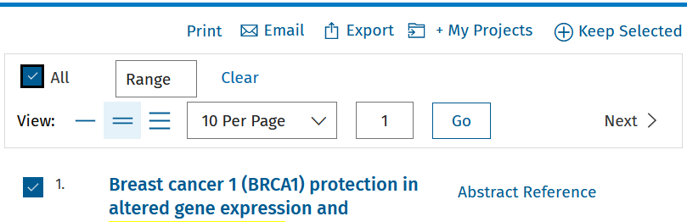
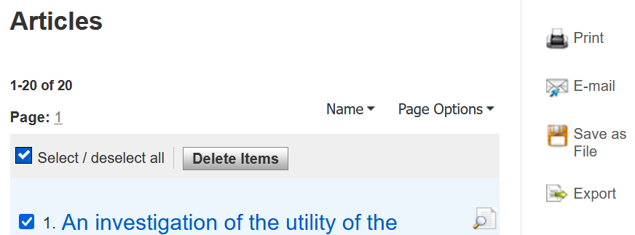
Library Academic Support Team
Exporting results
Get A&I database results in a format reference management tools will accept.
Often located above a results list.
Look for:
Export, Download, Share, Save…
Notes:
You can also take out records from the databases to store for your own use.
The command to do this for CINAHL (on the left) is under the "Share" command which presents you with the options highlighted in the purple dashes. For MEDLINE on the right here, you would choose Export, also in purple dashes to download a file of the records you have selected which could be individual ones from a list or “All” of them, using the command you can see ticked on that illustration.
To do the same in CINAHL you select the top “Share” option, under “Add to folder” heading which is the “Results” link. This puts the results you select into a temporary folder. The results can be from different searches during one session, or everything from one search by selecting all of the page on display (for which the maximum you can choose is 50) The contents of this temporary folder clear when you leave the session, however, when you have something in one, “Folder View” appears and the solid arrows lead you to the options you get when you go into that Folder View. They include “Export” to download a file of the records you have put in the folder.
To get all the results of a search out of CINAHL with one click, choose the link labelled "E-mail a link to download exported results" under “Export results” at the bottom of the “Share” menu. You get an email which contains a link to where the records you have asked for have been saved.

Slide 15
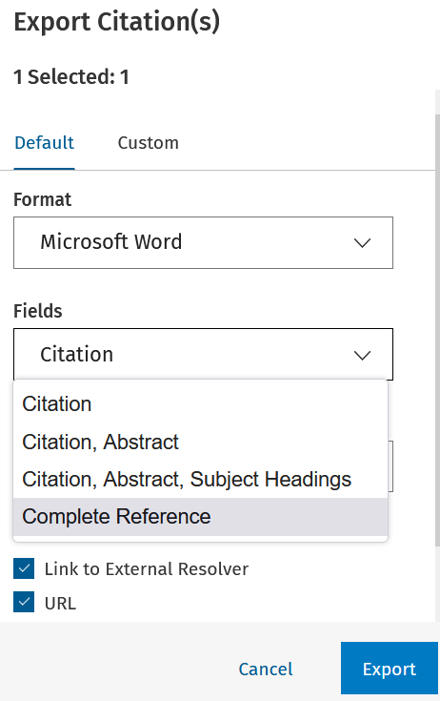
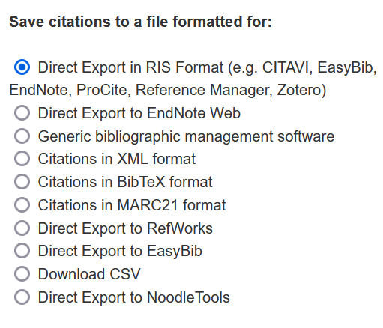
Library Academic Support Team
Exporting results: file types
Choose
the file type you need
how much of the records you need, if there is a choice.
RIS – generic file type for any reference managers.
Also:
RIS - Covidence
Notes:
When choosing to export, you get choices on what format to get the results. These usually include an option for text or Word and one that works for spreadsheets (CSV from the list on the left).
You may see in the list the names of reference management software tools, EndNote, Zotero or Mendeley for example. Reference managers allow you to create your own collections of references, organise them, save related full-text or other files with those records and to get automatic citing in Word, using a “Cite While You Write” widget that comes with the reference manager. The file type to export which will work for all of them is often labelled “RIS”. As ringed at the top of the list on the left.
RIS files are also accepted by the web-based tool called “Covidence” which has been designed for the screening process in a systematic style review and information on how to access it and reference managers is in a following slide.
When you have made your file type choice, there may also be a choice of how much of a record to keep as in the illustration on the right, where by default a "Citation" is on offer. Before settling for that option, look at the menu choices and choose a more useful selection which includes an abstract or the whole record, if that is better.

Slide 16


Reference management software
Library Academic Support Team
Useful because they let you:
Keep and group details of papers etc you have used, or read or plan on reading.
“Cite while you write” – automatically create in-text citations and reference lists in a variety of bibliographic/citation styles, including Harvard and APA.
Attach files (eg full-text pdfs of articles).
To help you decide which reference management products to use:
Bibliographic management tools - comparison table (pdf)
Choosing a Reference Manager documents on Sharepoint
EndNote desktop is free to download by members of the University but you must use Software Services’ forms:
EndNote desktop free download
For a systematic review, Covidence is useful for de-duplicating and screening records:
Register for Covidence under the University subscription
Notes:
If you are not already using a reference management software product yet, the table and the resources linked to from this slide may help you decide which one to go for. You can install EndNote for free for your own personal devices using the University’s subscription by going through Software Services. These tools let you organise your references in ways that match what you use for them for, grouping them in different ways and searching for those you want to use. As well as, as already mentioned, have the add-in that allows you to create automatic in-text citations and full reference lists in a variety of citation styles whilst using Word.
The systematic review screening tool mentioned, “Covidence”, is also licensed by the University for staff and student use. You can set up multiple "projects" which means you can set up a practice project before running a systematic review project. Again, register through the University's subscription.
Both tools have automatic de-duplication features.

Slide 17
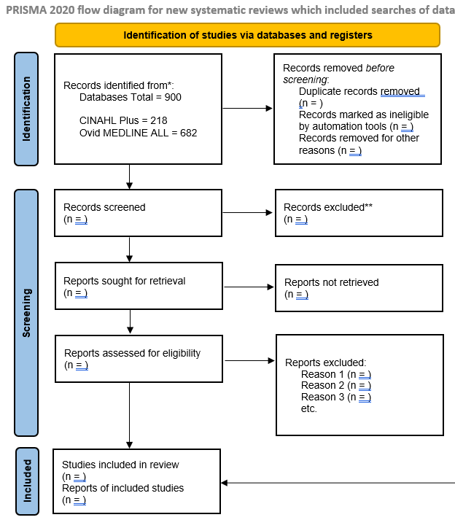
Library Academic Support Team
PRISMA flow diagram
Export Search Histories as reminders for writing up your method & reporting result numbers.
Interface - EBSCOhost Research Databases, Fri, September 27, 2024 10:15:24 am
Database - CINAHL Plus
# | Query | Results
S3 | S1 AND S2 | 228
S2 | neurodevelop* OR "neuro develop*" | 13,964
S1 | "fetal alcohol" OR "foetal alcohol" | 2,828
Ovid MEDLINE(R) ALL <1946 to September 26, 2024>
1 ("foetal alcohol" or "fetal alcohol").mp. 6860
2 (neurodevelop* or "neuro develop*").mp. 60935
3 1 and 2 682
www.prisma-statement.org
> PRISMA 2020 flow diagram
Notes:
As we have said, some pieces of work require you to report the numbers of records found and how those numbers changed during a screening process when you assess each result against all the criteria you have decided are important for you to see reported or done, before being willing to include a work in your review.
You may need to read only a title or an abstract, or you need to read more before being able to make this decision.
One of the ways this process can be presented is using a PRISMA flow diagram shown on the right. This Word template comes from the PRISMA website but the numbers you use to populate it are your own. Those which go in the top left box for “Records identified from”, and which is the starting box if you like, come from the searches you have done in the databases. This is one of the reasons suggested earlier for keeping hold of your Search Histories, example illustrations from which are on the left.
For systematic style reviews there is an expectation that more than one academic literature database will have been searched, and because databases for related disciplines will index the contents of some of the same publications, there is an understanding that you will find out about the same piece of work more than once. This is why in the top right box, “Records removed before screening” there is a line to record the “Duplicate records removed”. This step allows you to only assess the same publication once. It is for this stage that the automatic de-duplication on offer from EndNote etc and Covidence is useful.
PRISMA, which stands for "Preferred Reporting Items for Systematic and Meta-analysis reviews", also makes available from its website a checklist against which to assess any systematic review you are reading. This checklist may also give a good idea of what to consider when conducting your own systematic style review too.

Slide 18

DiscoverEd for journal articles
Library Academic Support Team
To know whether or not you can read an article published in the issue of a particular journal [magazine]:
Look up the journal title in DiscoverEd.
Use the limiting/filtering options available.
https://discovered.ed.ac.uk
Notes:
One reason you may not be able to consider a work for your review would be that you are unable to get hold of the whole thing. In the PRISMA flow diagram in the previous slide, this would be recorded in the “reports not retrieved” box.
To know whether or not you can get the full text of something from the library, check DiscoverEd, and for journal articles look up the journal it was published in.
You can limit the search at the start to return results only about journal titles as was done in the illustration here, Journals having been selected from the materials type menu, and the words to appear in the Title. Check the full records of what comes back to be sure we do not have the journal for the issue you want, neither online nor in print.
If you are a member of another organisation that has library services, then that is great. If we don't have something, they might, so look up any library service information they provide, for example, NHS Education for Scotland's "Knowledge network".

Slide 19
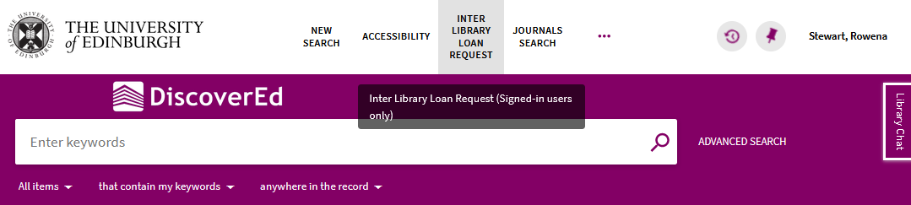
Library Academic Support Team
Inter-Library Loan (I.L.L.) service
www.ed.ac.uk/is/inter-library
For when The Library does not have what you want at all
Scan of part (article, chapter etc) to keep, or
Physical items to borrow
Free per year (after which £5 per request received):
5 for undergraduates
30 for postgraduates and staff
2 renewals which are done via Helpdesk or I.L.L. staff.
Notes:
But if you know the library here at UoEdinburgh does not have what you want, you can make use of our inter-library loan service. Sign In to DiscoverEd to be able to use the form that becomes available from the INTER LIBRARY LOAN REQUEST option in the top menu.
You can ask for a copy of an article or a chapter within a book to keep (or a whole hardcopy book etc if you are in Edinburgh and can collect and return from one of the University’s libraries). You can get 30 of these free a year (five for undergraduates).

Slide 20
Library Academic Support Team
Help
Please get in touch to
ask about any library-related problems or questions or to
arrange to meet for help with finding academic literature.
Rowena Stewart
rowena.stewart@ed.ac.uk
(she/her)
Academic Support Librarian
Literature searching advice (for Nursing) guide
Notes:
If there is something you want to read but it looks like we do not have it, I am happy to help check that for you. I am also happy to try to answer any other questions or problems you have with library resources or services and to arrange to meet to demo searching on the databases or similar if that becomes useful.
The Nursing guide has some other potentially useful bits and pieces which can help so have a look at that too but please get in touch if you think I can help. Thank you.

